Slide 1
Advanced Web programming
Lec-7
Introduction to Visual Studio

Slide 2
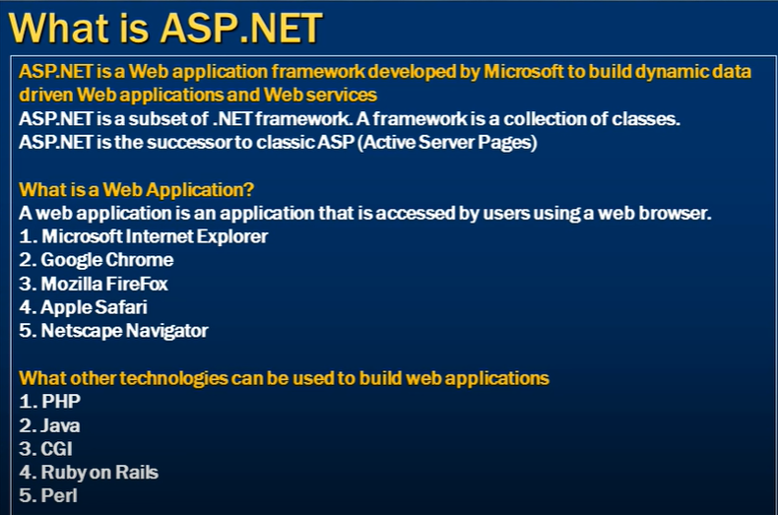

Slide 3
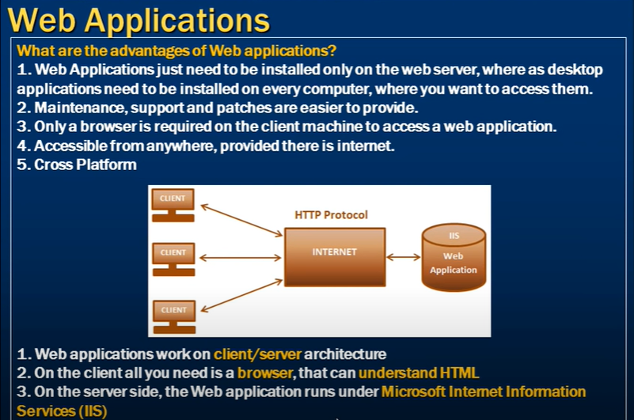

Slide 4
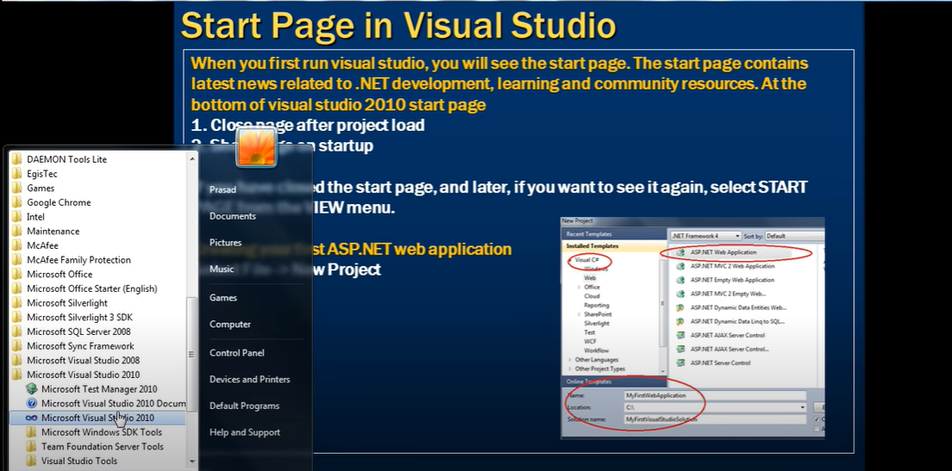

Slide 5
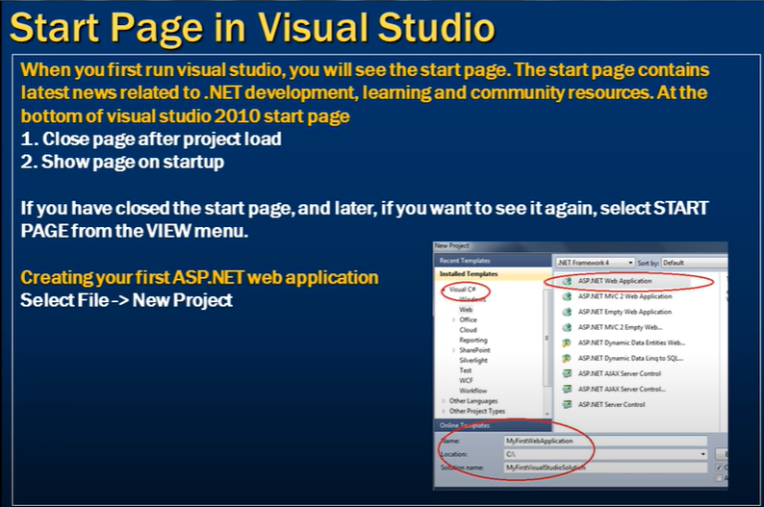

Slide 6
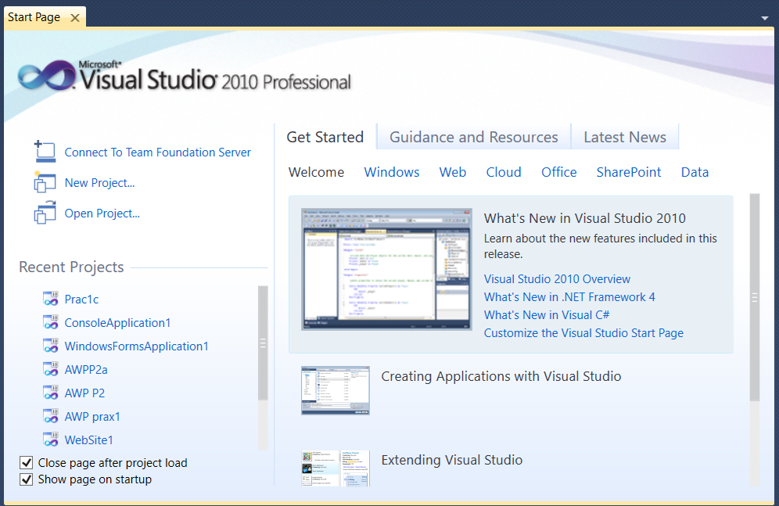
Introduction to Visual studio

Slide 7
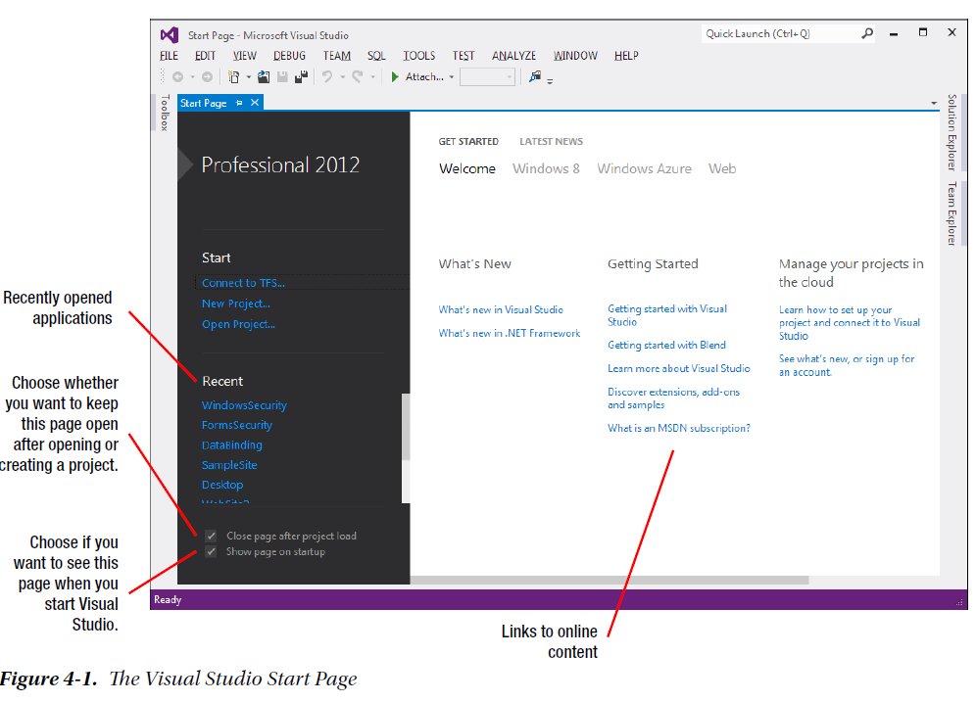

Slide 8
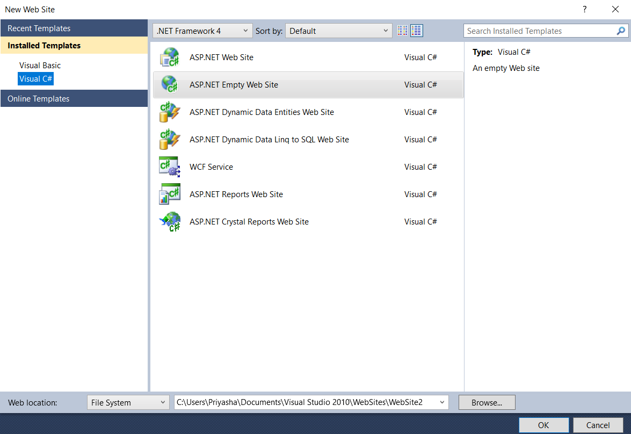

Slide 9
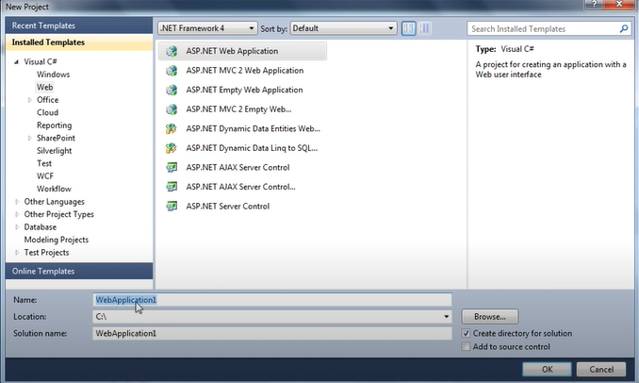

Slide 10
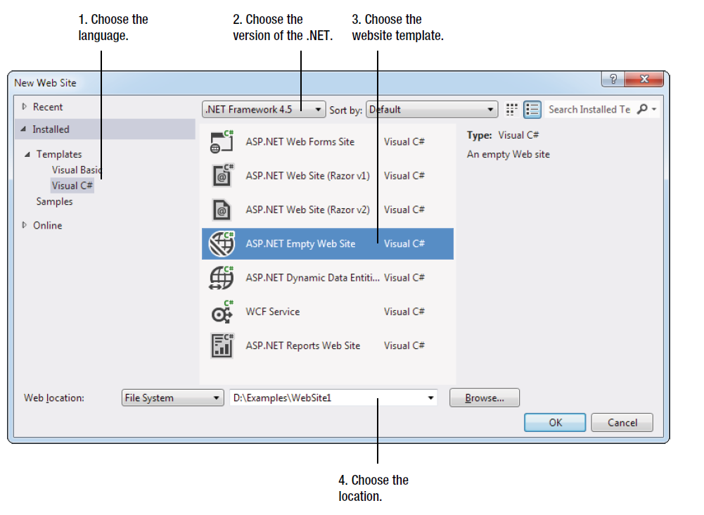
Creating an Empty Web Application
To create your first Visual Studio application, follow these steps:
1. Choose File ➤ New ➤ Web Site from the Visual Studio menu. The New Web Site dialog box appears, as shown;

Slide 11
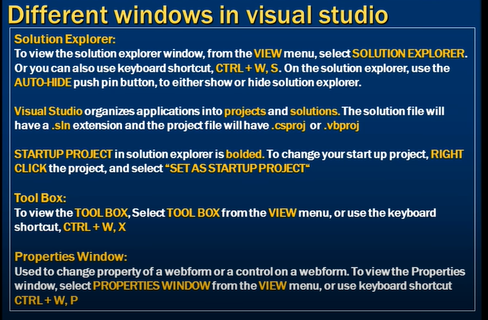

Slide 12
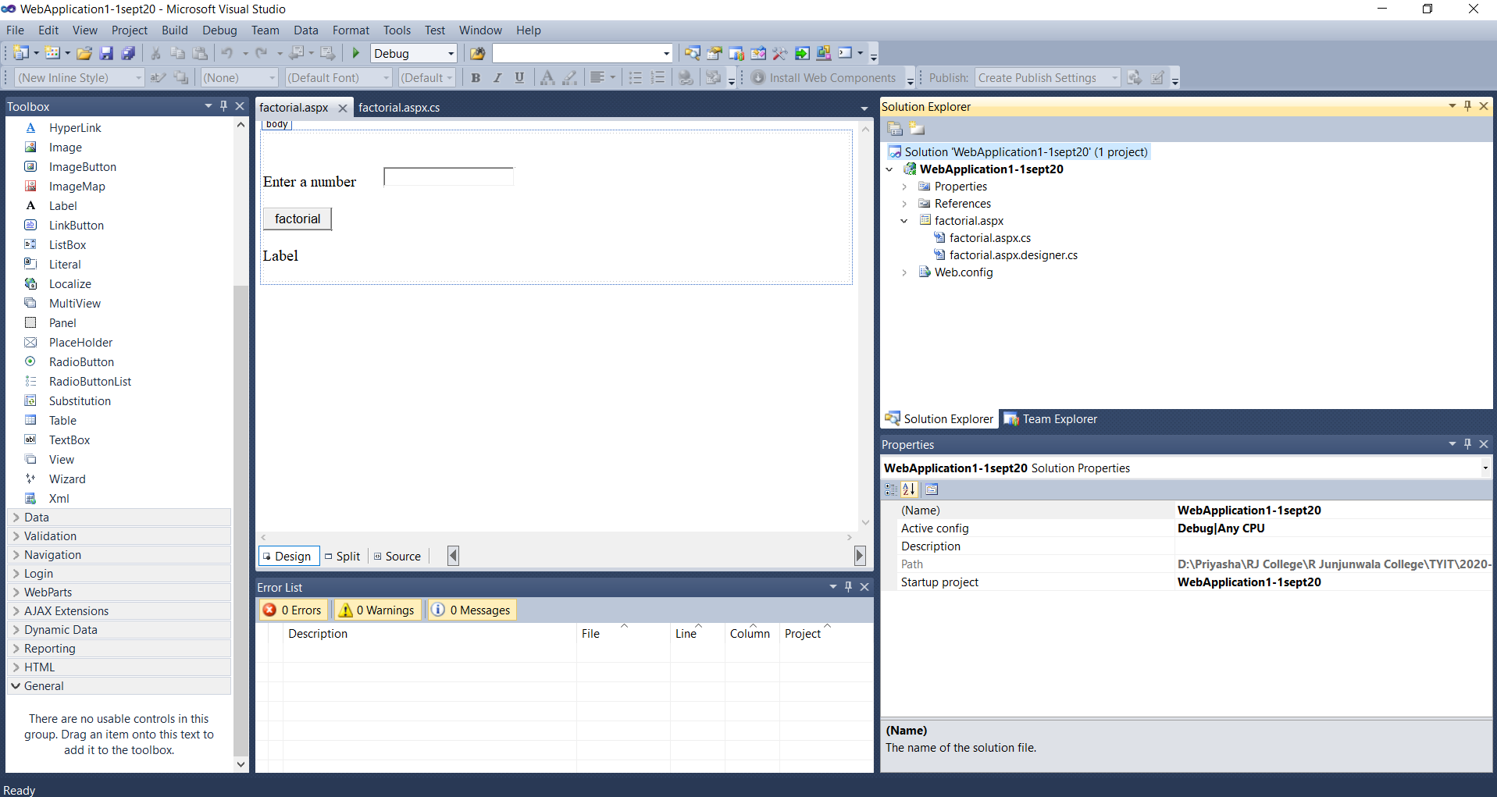

Slide 13
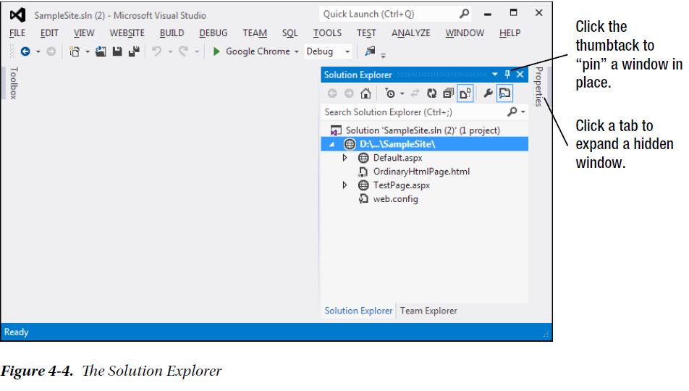

Slide 14
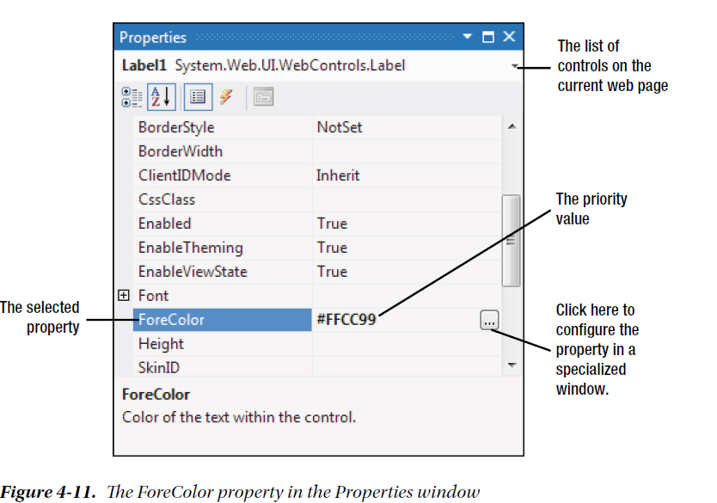

Slide 15
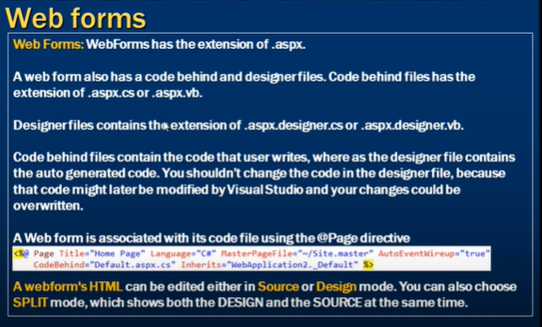

Slide 16
Visual Studio is an indispensable tool for developers on any platform. It provides several impressive benefits:
1.Integrated error checking: Visual Studio can detect a wide range of problems, such as data type conversion errors, missing namespaces or classes, and undefined variables. Errors are detected, underlined, and added to an error list for quick reference.
2. The web form designer: To create a web page in Visual Studio, you can simply drag ASP.NET controls to the appropriate location and configure their properties. Visual Studio does the heavy lifting and automatically creates the actual web page markup.
3. An integrated web server: To run an ASP.NET web application, you need a web server running the Internet Information Services (IIS) web server software. The web server has a straightforward job—it waits for browser requests and serves the appropriate pages. The integrated development web server in Visual Studio, can run a website directly from the design environment.
4. Developer productivity enhancements: Visual Studio makes coding quick and efficient with a collapsible code display, automatic statement completion, and color-code syntax.
5. Fine-grained debugging: Visual Studio’s integrated debugger allows you to watch code execution, pause the program at any point, and inspect the contents of any variable. These debugging tools can save endless headaches when writing complex code routines.

Slide 17
The Web Form Markup
Every ASP.NET web form includes the standard HTML tags, such as <html>, <head>, and <body>, which delineate the basic sections of your web page.
You can insert additional HTML tags, such as paragraphs of text (use the <p> tag), headings (use <h1>, <h2>, <h3>), tables (use <table>), and so on.
Along with standard HTML, you can add ASP.NET-only elements to your web pages. For example, <asp:Button> represents a clickable button that triggers a task on the web server.
Every HTML document starts out with this basic structure (right after the doctype):
<html>
<head runat = "server">
<title > Untitled Page</title>
</head>
<body>
</body>
</html>

Slide 18
The Page Directive
The Default.aspx page, like all ASP.NET web forms, consists of three sections. The first section is the page
directive:
<%@ Page Language = "C#" AutoEventWireup = "true"
CodeFile = "Default.aspx.cs" Inherits = "_Default" %>
The page directive gives ASP.NET basic information about how to compile the page. It indicates the language used for the code and the way event handlers are connected.
During the code-behind approach, the page directive also indicates where the code file is located and the name of your custom page class.
The page directive doesn’t appear in the HTMl that’s sent to the browser.

Slide 19
Writing Code
Many of Visual Studio’s enhancements appear when you start to write the code that supports your user interface.
To start coding, you need to switch to the code-behind view. To switch back and forth, you can use two View Code or View Designer buttons, which appear just above the Solution Explorer window.
Another approach that works just as well is to double-click either the .aspx page in the Solution Explorer (to get to the designer) or the .aspx.cs page (to get to the code view).
The code is the C# code, not the HTML markup in the .aspx file.

Slide 20
Using the Code-Behind Class
When we switch to code view, the page class for the web page is seen.
For example, if you've created a web page named SimplePage.aspx, you'll see a code-behind class that looks like this:
using System;
using System;
using System.Collections.Generic;
using System.Linq;
using System.Web;
using System.Web.UI;
using System.Web.UI.WebControls;
public partial class SimplePage: System.Web.UI.Page
{
protected void Page_Load(object sender, EventArgs e)
{
}
}

Slide 21
Visual Studio imports a number of core .NET namespaces. These namespaces give you easy access to many commonly used ASP.NET classes.
Inside the page class we can place methods, which will respond to control events.
For example, you can add a method with code that reacts when the user clicks a button.
When you use Visual Studio to attach or create an event handler, it adjusts the control tag so that it's linked to the appropriate event:
<asp:Button ID = "Button1" runat = "server" Text = "Button" OnClick = "Button1_Click" />
Inside the event handler method, you can interact with any of the control objects on the web page by using their IDs.
For example, if a TextBox control is created & named as TextBox1, you can set the text by using the following line of code:
protected void Button1_Click(object sender, EventArgs e)
{
TextBox1.Text = “Here is some sample text.”;
}
This is a simple event handler that reacts when Button1 is clicked and updates the text in TextBox1.

Slide 22
Adding Event Handlers
Most of the code in an ASP.NET web page is placed inside event handlers that react to web control events.
Using Visual Studio, we’ve three easy ways to add an event handler to your code:
1. Type it in manually: In this case, you add the subroutine directly to the page class in your C# code file. You must specify the appropriate parameters.
2. Double-click a control in design view: In this case, Visual Studio will create an event handler for that control’s default event, if it doesn’t already exist.
For example, double-click a Button control, it will create an event handler for the Button.Click event. If you double-click a TextBox control, you’ll get an event handler for the TextBox.TextChanged event. If the event handler already exists, Visual Studio simply takes you to the relevant place in your code.
3. Choose the event from the Properties window: Just select the control, and click the lightning bolt in the Properties window. You’ll see a list of all the events provided by that control. Double-click next to the event you want to handle, and Visual Studio will automatically generate the event handler in your page class.

Slide 23
Designer file- automatic designer generated code when we design.
The code behind file contains the code that user writes with .cs extension. On page load what should happen
.aspx file contains the presentation that is the HTML File
The Solution -the Solution Explorer window at the top-right corner of the design environment lists all the files in your web application directory.

Slide 24
To be continued….

